Slide 1
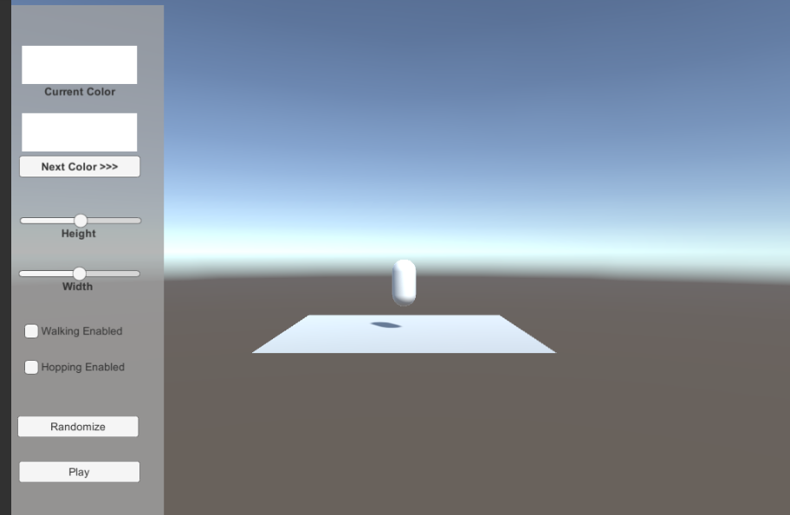
Character Generator
Megan Truesdale

Slide 2
Objective:
To create a system to generate and/or customize characters.

Slide 3
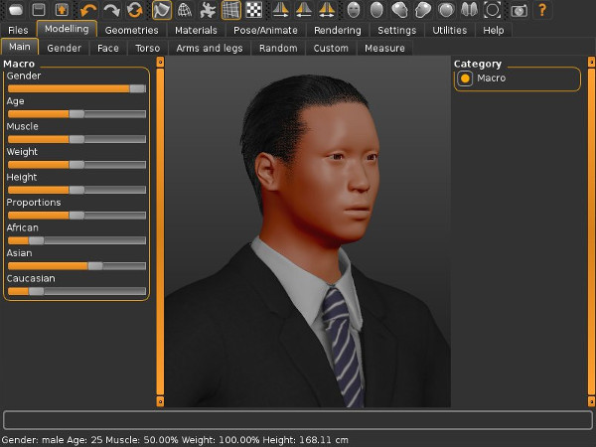
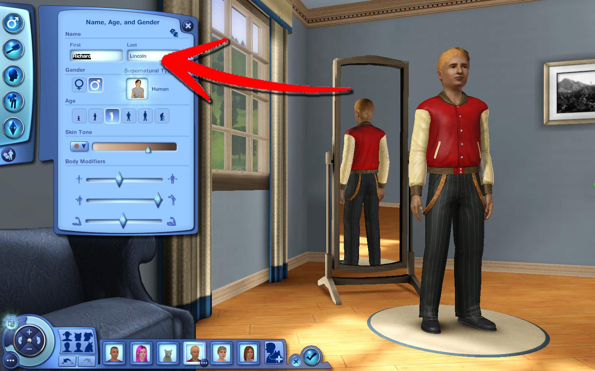
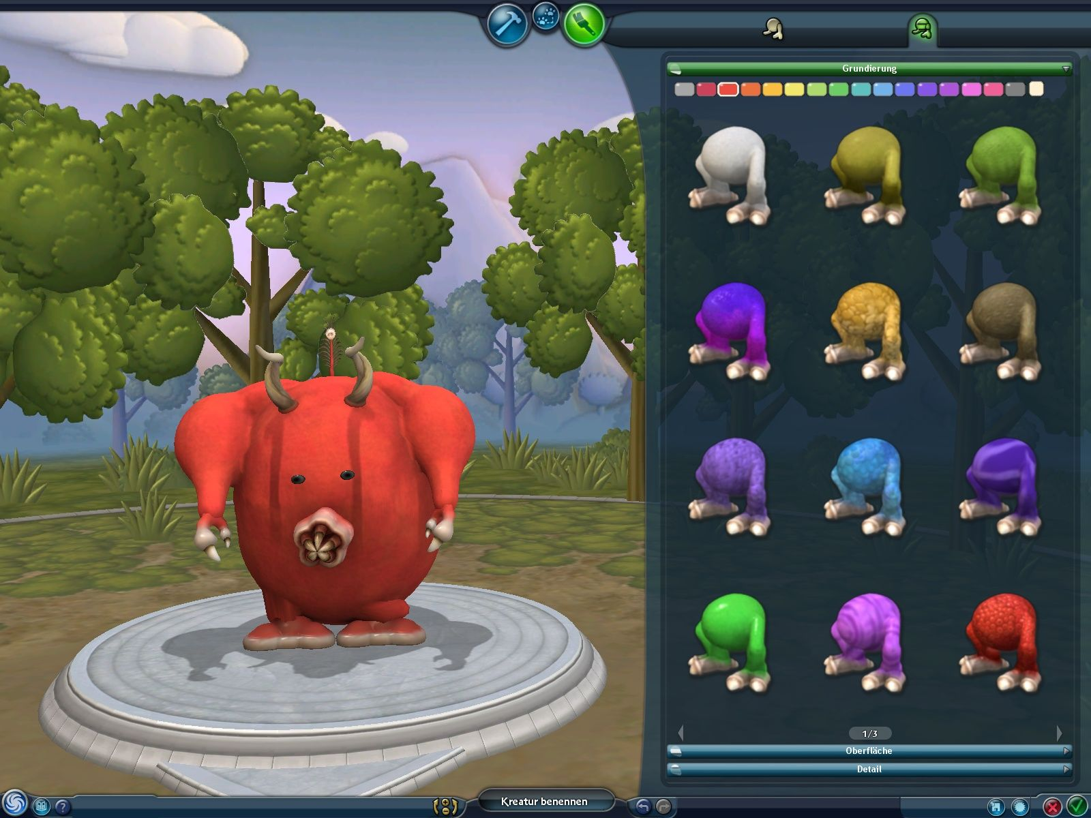
Games
Sims
Spore (Creature Creator)
MakeHuman

Slide 4
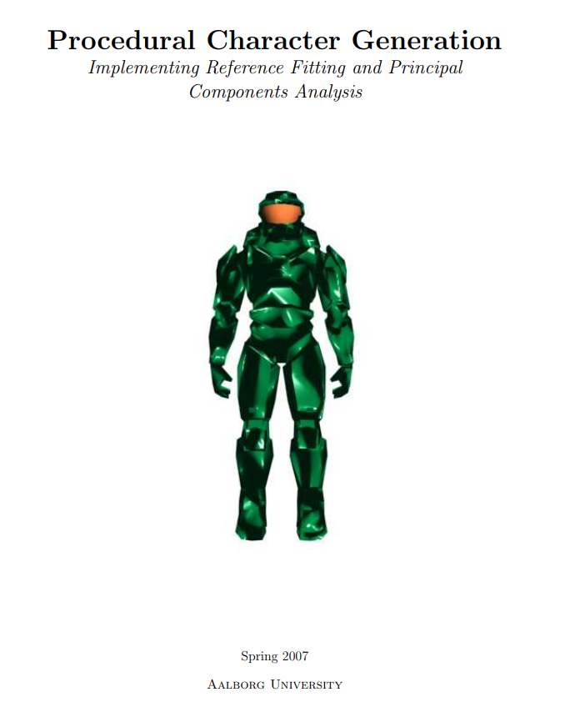
Research
Procedural Character Generation -Aalborg University
Procedural Characters and the Coming Animation Technology Revolution
http://aigamedev.com/open/editorial/animation-revolution/
6 Techniques for Leveraging AI in Content Generation
https://www.gdcvault.com/play/1024146/PCG-Shotgun-6-Techniques-for
Spore’s Creature Creator
https://www.technologyreview.com/s/410281/creating-creatures/
Unity Spawn Tutorial
https://unity3d.com/learn/tutorials/projects/survival-shooter/more-enemies

Slide 5
Implementation
I created a UI system so the user could customize the character.
I created functionality to randomly create and customize characters.

Slide 6
Code
I created three scripts:
Generator Script
Systematic Generator Script
BaseObject Script
The Generator Script manages UI and accesses booleans within the base object to adjust values and behaviors.

Slide 7

What Went Well
It builds.
It functions.
I learned a lot and had fun!

Slide 8

Challenges
Scaling the object was not working because Unity doesn't allow you to change the value of a property being animated.
If you change the localscale value of an object in playmode it will be overwritten back to the animated value.
To work around this I created a Vector 3 variable to adjust the scale.
I didn’t get to implement the color selector so the user could select a unique color. Instead the colors are only generated randomly.
Spent about 6 hours confused as to why gameObjects wouldn’t move, I figured out I forgot to add a rigidbody to the prefab.

